Slide 1
Boolean Function
A Boolean function expresses the logical relationship between binary variables.
A Boolean function | binary variables
 | binary operators OR and AND
 | unary operator NOT
 | parentheses
Examples | F₁= x + y · z‘
 | F₂ = x‘ · y’ · z + x‘ · (y + z) + x · y’

Slide 2
Boolean
Function
Equivalence
True
Table
Logic
Circuit

Slide 3
Boolean
Function
Equivalence
True
Table
Logic
Circuit

Slide 4
Boolean Function to Logic Circuit
  F₁= x + y’ z

Slide 5
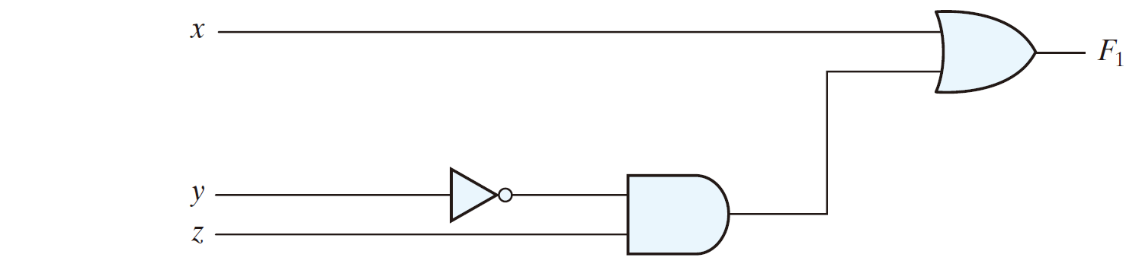
Boolean Function to Logic Circuit
  F₁= x + y’ z

Slide 6
Boolean Function to Logic Circuit
  F₁= x + y’ z

Slide 7
Boolean Function to Logic Circuit
  F₁= x + y’ z

Slide 8
Boolean Function to True Table
A true table can be developed from a Boolean function.

Slide 9
Boolean Function to True Table
  Develop a true table from the Boolean expression F₁= x + y’ z.

Slide 10
Boolean
Function
Equivalence
True
Table
Logic
Circuit

Slide 11
Boolean Function to True Table
x | y | z | F₁
  F₁= x + y’ z

Slide 12
Boolean Function to True Table
x | y | z | F₁
0 | 0 | 0
0 | 0 | 1
0 | 1 | 0
0 | 1 | 1
1 | 0 | 0
1 | 0 | 1
1 | 1 | 0
1 | 1 | 1
  F₁= x + y’ z

Slide 13
Boolean Function to True Table
x | y | z | F₁
0 | 0 | 0
0 | 0 | 1
0 | 1 | 0
0 | 1 | 1
1 | 0 | 0
1 | 0 | 1
1 | 1 | 0
1 | 1 | 1
  F₁= x + y’ z
= 0 + 0’ · 0 = 0 + 1 · 0 = 0 + 0 = 0

Slide 14
Boolean Function to True Table
x | y | z | F₁
0 | 0 | 0 | 0
0 | 0 | 1
0 | 1 | 0
0 | 1 | 1
1 | 0 | 0
1 | 0 | 1
1 | 1 | 0
1 | 1 | 1
  F₁= x + y’ z
= 0 + 0’ · 0 = 0 + 1 · 0 = 0 + 0 = 0

Slide 15
Boolean Function to Logic Circuit
  F₁= x + y’ z
0
0
0

Slide 16
Boolean Function to Logic Circuit
  F₁= x + y’ z
0
0
1
0

Slide 17
Boolean Function to Logic Circuit
  F₁= x + y’ z
0
0
1
0
0

Slide 18
Boolean Function to Logic Circuit
  F₁= x + y’ z
0
0
0
1
0
0

Slide 19
Boolean Function to True Table
x | y | z | F₁
0 | 0 | 0 | 0
0 | 0 | 1
0 | 1 | 0
0 | 1 | 1
1 | 0 | 0
1 | 0 | 1
1 | 1 | 0
1 | 1 | 1
  F₁= x + y’ z
= 0 + 0’ · 1 = 0 + 1 · 1 = 0 + 1 = 1

Slide 20
Boolean Function to True Table
x | y | z | F₁
0 | 0 | 0 | 0
0 | 0 | 1 | 1
0 | 1 | 0
0 | 1 | 1
1 | 0 | 0
1 | 0 | 1
1 | 1 | 0
1 | 1 | 1
  F₁= x + y’ z
= 0 + 0’ · 1 = 0 + 1 · 1 = 0 + 1 = 1

Slide 21
Boolean Function to Logic Circuit
  F₁= x + y’ z
0
0
1

Slide 22
Boolean Function to Logic Circuit
  F₁= x + y’ z
0
0
1
1

Slide 23
Boolean Function to Logic Circuit
  F₁= x + y’ z
0
0
1
1
1

Slide 24
Boolean Function to Logic Circuit
  F₁= x + y’ z
0
1
0
1
1
1

Slide 25
Boolean Function to True Table
x | y | z | F₁
0 | 0 | 0 | 0
0 | 0 | 1 | 1
0 | 1 | 0
0 | 1 | 1
1 | 0 | 0
1 | 0 | 1
1 | 1 | 0
1 | 1 | 1
  F₁= x + y’ z
= 0 + 1’ · 0 = 0 + 0 · 0 = 0 + 0 = 0

Slide 26
Boolean Function to True Table
x | y | z | F₁
0 | 0 | 0 | 0
0 | 0 | 1 | 1
0 | 1 | 0 | 0
0 | 1 | 1
1 | 0 | 0
1 | 0 | 1
1 | 1 | 0
1 | 1 | 1
  F₁= x + y’ z
= 0 + 1’ · 0 = 0 + 0 · 0 = 0 + 0 = 0

Slide 27
Boolean Function to True Table
x | y | z | F₁
0 | 0 | 0 | 0
0 | 0 | 1 | 1
0 | 1 | 0 | 0
0 | 1 | 1
1 | 0 | 0
1 | 0 | 1
1 | 1 | 0
1 | 1 | 1
  F₁= x + y’ z
= 0 + 1’ · 1 = 0 + 0 · 1 = 0 + 0 = 0

Slide 28
Boolean Function to True Table
x | y | z | F₁
0 | 0 | 0 | 0
0 | 0 | 1 | 1
0 | 1 | 0 | 0
0 | 1 | 1 | 0
1 | 0 | 0
1 | 0 | 1
1 | 1 | 0
1 | 1 | 1
  F₁= x + y’ z
= 0 + 1’ · 1 = 0 + 0 · 1 = 0 + 0 = 0

Slide 29
Boolean Function to True Table
x | y | z | F₁
0 | 0 | 0 | 0
0 | 0 | 1 | 1
0 | 1 | 0 | 0
0 | 1 | 1 | 0
1 | 0 | 0
1 | 0 | 1
1 | 1 | 0
1 | 1 | 1
  F₁= x + y’ z
= 1 + 0’ · 0 = 1 + 1 · 0 = 1 + 0 = 1

Slide 30
Boolean Function to True Table
x | y | z | F₁
0 | 0 | 0 | 0
0 | 0 | 1 | 1
0 | 1 | 0 | 0
0 | 1 | 1 | 0
1 | 0 | 0 | 1
1 | 0 | 1
1 | 1 | 0
1 | 1 | 1
  F₁= x + y’ z
= 1 + 0’ · 0 = 1 + 1 · 0 = 1 + 0 = 1

Slide 31
Boolean Function to Logic Circuit
  F₁= x + y’ z
1
0
0

Slide 32
Boolean Function to Logic Circuit
  F₁= x + y’ z
1
0
1
0

Slide 33
Boolean Function to Logic Circuit
  F₁= x + y’ z
1
0
1
0
0

Slide 34
Boolean Function to Logic Circuit
  F₁= x + y’ z
1
1
0
1
0
0

Slide 35
Boolean Function to True Table
x | y | z | F₁
0 | 0 | 0 | 0
0 | 0 | 1 | 1
0 | 1 | 0 | 0
0 | 1 | 1 | 0
1 | 0 | 0 | 1
1 | 0 | 1
1 | 1 | 0
1 | 1 | 1
  F₁= x + y’ z
= 1 + 0’ · 1 = 1 + 1 · 1 = 1 + 1 = 1

Slide 36
Boolean Function to True Table
x | y | z | F₁
0 | 0 | 0 | 0
0 | 0 | 1 | 1
0 | 1 | 0 | 0
0 | 1 | 1 | 0
1 | 0 | 0 | 1
1 | 0 | 1 | 1
1 | 1 | 0
1 | 1 | 1
  F₁= x + y’ z
= 1 + 0’ · 1 = 1 + 1 · 1 = 1 + 1 = 1

Slide 37
Boolean Function to True Table
x | y | z | F₁
0 | 0 | 0 | 0
0 | 0 | 1 | 1
0 | 1 | 0 | 0
0 | 1 | 1 | 0
1 | 0 | 0 | 1
1 | 0 | 1 | 1
1 | 1 | 0
1 | 1 | 1
  F₁= x + y’ z
= 1 + 1’ · 0 = 1 + 0 · 0 = 1 + 0 = 1

Slide 38
Boolean Function to True Table
x | y | z | F₁
0 | 0 | 0 | 0
0 | 0 | 1 | 1
0 | 1 | 0 | 0
0 | 1 | 1 | 0
1 | 0 | 0 | 1
1 | 0 | 1 | 1
1 | 1 | 0 | 1
1 | 1 | 1
  F₁= x + y’ z
= 1 + 1’ · 0 = 1 + 0 · 0 = 1 + 0 = 1

Slide 39
Boolean Function to True Table
x | y | z | F₁
0 | 0 | 0 | 0
0 | 0 | 1 | 1
0 | 1 | 0 | 0
0 | 1 | 1 | 0
1 | 0 | 0 | 1
1 | 0 | 1 | 1
1 | 1 | 0 | 1
1 | 1 | 1
  F₁= x + y’ z
= 1 + 1’ · 1 = 1 + 0 · 1 = 1 + 0 = 1

Slide 40
Boolean Function to True Table
x | y | z | F₁
0 | 0 | 0 | 0
0 | 0 | 1 | 1
0 | 1 | 0 | 0
0 | 1 | 1 | 0
1 | 0 | 0 | 1
1 | 0 | 1 | 1
1 | 1 | 0 | 1
1 | 1 | 1 | 1
  F₁= x + y’ z
= 1 + 1’ · 1 = 1 + 0 · 1 = 1 + 0 = 1

Slide 41
Boolean Function to True Table
x | y | z | F₁
0 | 0 | 0 | 0
0 | 0 | 1 | 1
0 | 1 | 0 | 0
0 | 1 | 1 | 0
1 | 0 | 0 | 1
1 | 0 | 1 | 1
1 | 1 | 0 | 1
1 | 1 | 1 | 1
  F₁= x + y’ z

Slide 42
Boolean Function to Logic Circuit
Draw a logic diagram of the Boolean function F = x’ y + x y’.

Slide 43
Boolean Function to Logic Circuit
Draw a logic diagram of the Boolean function F = x’ y + x y’.

Slide 44
Boolean Function to Logic Circuit
Draw a logic diagram of the Boolean function F = x’ y + x y’.

Slide 45
Boolean Function to Logic Circuit
Draw a logic diagram of the Boolean function F = x’ y + x y’.

Slide 46
Boolean Function to Logic Circuit
Draw a logic diagram of the Boolean function F = x’ y + x y’.
x’ y

Slide 47
Boolean Function to Logic Circuit
Draw a logic diagram of the Boolean function F = x’ y + x y’.
x y’
x’ y

Slide 48
Boolean
Function
Equivalence
True
Table
Logic
Circuit

Slide 49
Logic Circuit to Boolean Function
What Boolean expression is implemented by the following logic diagram?
F

Slide 50
Logic Circuit to Boolean Function
What Boolean expression is implemented by the following logic diagram?
F = (x’ y + x y’)’
F

Slide 51
Logic Circuit to Boolean Function
What Boolean expression is implemented by the following logic diagram?
F = (x’ y + x y’)’
= (x’ y)’ · (x y’)’
F

Slide 52
Logic Circuit to Boolean Function
What Boolean expression is implemented by the following logic diagram?
F = (x’ y + x y’)’
= (x’ y)’ · (x y’)’
= (x + y’) · (x’ + y)
F

Slide 53
Logic Circuit to Boolean Function
What Boolean expression is implemented by the following logic diagram?
F = (x’ y + x y’)’
= (x’ y)’ · (x y’)’
= (x + y’) · (x’ + y)
= x x’ + x y + y’ x’ + y’ y
F

Slide 54
Logic Circuit to Boolean Function
What Boolean expression is implemented by the following logic diagram?
F = (x’ y + x y’)’
= (x’ y)’ · (x y’)’
= (x + y’) · (x’ + y)
= x x’ + x y + y’ x’ + y’ y
= x y + x’ y’
F

Slide 55
Logic Circuit to Boolean Function
What truth table is implemented by the logic diagram?
F

Slide 56
Logic Circuit to Boolean Function
What truth table is implemented by the logic diagram?
F = x y + x’ y’
F

Slide 57
Logic Circuit to Boolean Function
What truth table is implemented by the logic diagram?
F = x y + x’ y’
x | y | F
0 | 0
0 | 1
1 | 0
1 | 1
F

Slide 58
Logic Circuit to True Table
What truth table is implemented by the logic diagram?
F = x y + x’ y’
x | y | F
0 | 0 | 1
0 | 1 | 0
1 | 0 | 0
1 | 1 | 1
F

Slide 59
Boolean Function to True Table
  F₂ = x' y' z + x' y z + x y’

Slide 60
Boolean Function to Logic Circuit
  F₂ = x' y' z + x' y z + x y’
x | y | z | F₂
0 | 0 | 0
0 | 0 | 1
0 | 1 | 0
0 | 1 | 1
1 | 0 | 0
1 | 0 | 1
1 | 1 | 0
1 | 1 | 1

Slide 61
Boolean Function to Logic Circuit
  F₂ = x' y' z + x' y z + x y’
x | y | z | F₂
0 | 0 | 0
0 | 0 | 1
0 | 1 | 0
0 | 1 | 1
1 | 0 | 0
1 | 0 | 1
1 | 1 | 0
1 | 1 | 1
  = 0’ · 0’ · 0 + 0’ · 0 · 0 + 0 · 0’
  = 1 · 1 · 0 + 1 · 0 · 0 + 0 · 1
  = 0 + 0 + 0
  = 0

Slide 62
Boolean Function to Logic Circuit
  F₂ = x' y' z + x' y z + x y’
x | y | z | F₂
0 | 0 | 0 | 0
0 | 0 | 1
0 | 1 | 0
0 | 1 | 1
1 | 0 | 0
1 | 0 | 1
1 | 1 | 0
1 | 1 | 1
  = 0’ · 0’ · 0 + 0’ · 0 · 0 + 0 · 0’
  = 1 · 1 · 0 + 1 · 0 · 0 + 0 · 1
  = 0 + 0 + 0
  = 0

Slide 63
Boolean Function to Logic Circuit
  F₂ = x' y' z + x' y z + x y’
x | y | z | F₂
0 | 0 | 0 | 0
0 | 0 | 1
0 | 1 | 0
0 | 1 | 1
1 | 0 | 0
1 | 0 | 1
1 | 1 | 0
1 | 1 | 1
  = 0’ · 1’ · 1 + 0’ · 1 · 1 + 0 · 1’
  = 1 · 0 · 1 + 1 · 1 · 1 + 0 · 0
  = 0 + 1 + 0
  = 1

Slide 64
Boolean Function to Logic Circuit
  F₂ = x' y' z + x' y z + x y’
x | y | z | F₂
0 | 0 | 0 | 0
0 | 0 | 1
0 | 1 | 0
0 | 1 | 1 | 1
1 | 0 | 0
1 | 0 | 1
1 | 1 | 0
1 | 1 | 1
  = 0’ · 1’ · 1 + 0’ · 1 · 1 + 0 · 1’
  = 1 · 0 · 1 + 1 · 1 · 1 + 0 · 0
  = 0 + 1 + 0
  = 1

Slide 65
Boolean Function to Logic Circuit
  F₂ = x' y' z + x' y z + x y’
x | y | z | F₂
0 | 0 | 0 | 0
0 | 0 | 1 | 1
0 | 1 | 0 | 0
0 | 1 | 1 | 1
1 | 0 | 0 | 1
1 | 0 | 1 | 1
1 | 1 | 0 | 0
1 | 1 | 1 | 0

Slide 66
Why we need to Simplify Boolean Function?

Slide 67
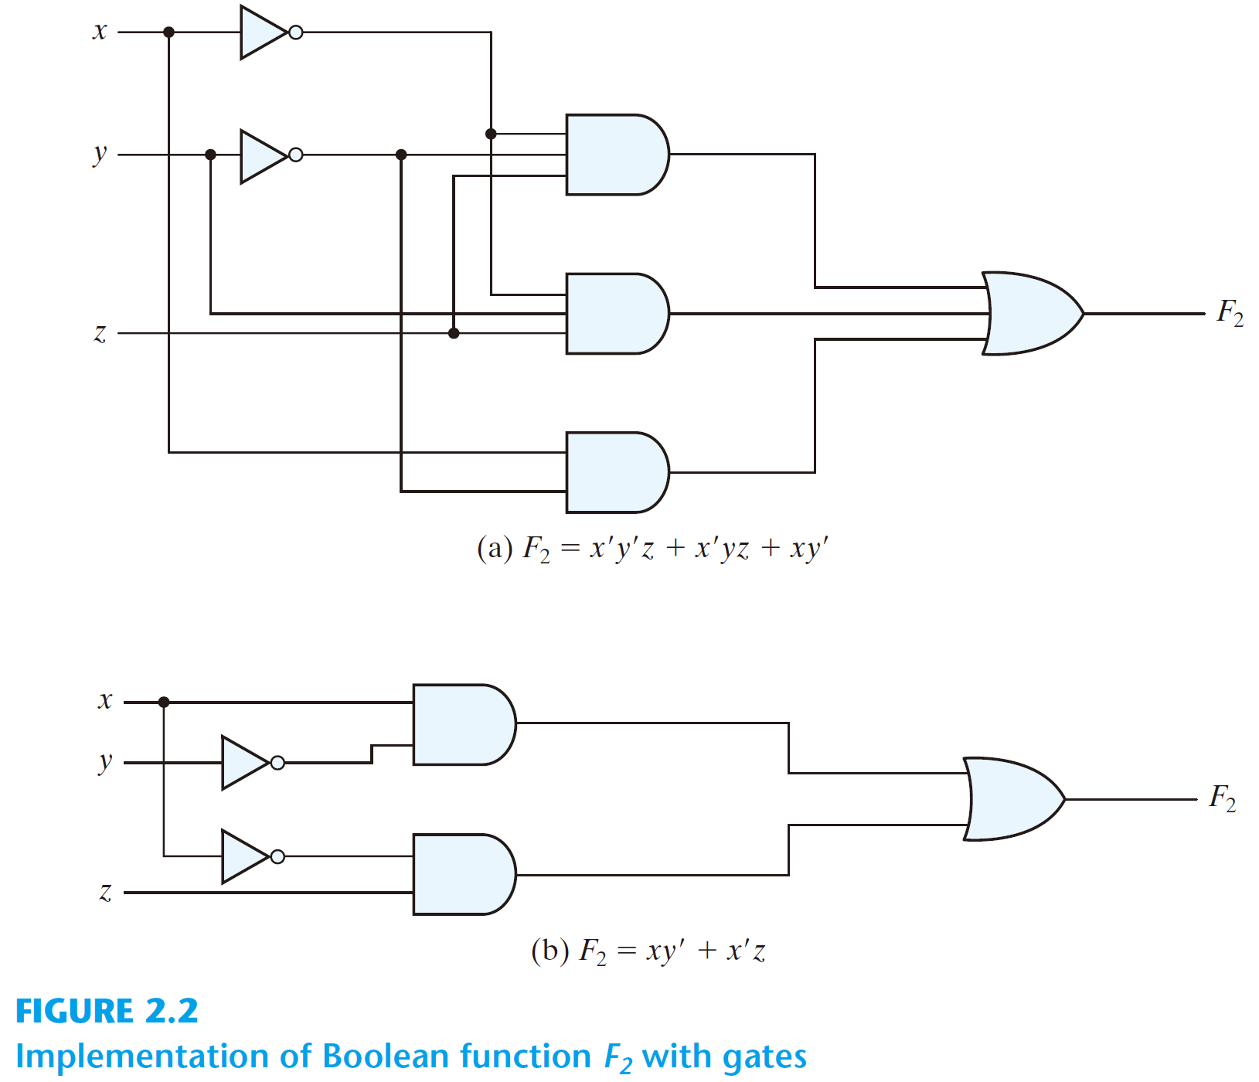
Boolean Function to Logic Circuit
  F₂ = x' y' z + x' y z + x y’

Slide 68
Boolean Function Simplification
  F₂ = x’ y’ z + x’ y z + x y’

Slide 69
Boolean Function Simplification
  F₂ = x’ y’ z + x’ y z + x y’
  = x’ z (y’ + y) + x y’

Slide 70
Boolean Function Simplification
  F₂ = x’ y’ z + x’ y z + x y’
  = x’ z (y’ + y) + x y’
  = x’ z + x y’

Slide 71
Boolean Function Simplification
  F₂ = x’ z + x y’

Slide 72
Boolean Function Simplification
  F₂ = x’ z + x y’

Slide 73
Boolean Function Simplification
  F₂ = x' y' z + x' y z + x y’
  F₂ = x’ z + x y’

Slide 74
Algebraic Manipulation
To minimize Boolean expressions
  literal: a primed or unprimed variable (an input to a gate)
  term: an implementation with a gate
  The minimization of the number of literals and the number of terms → a circuit with less equipment

Slide 75
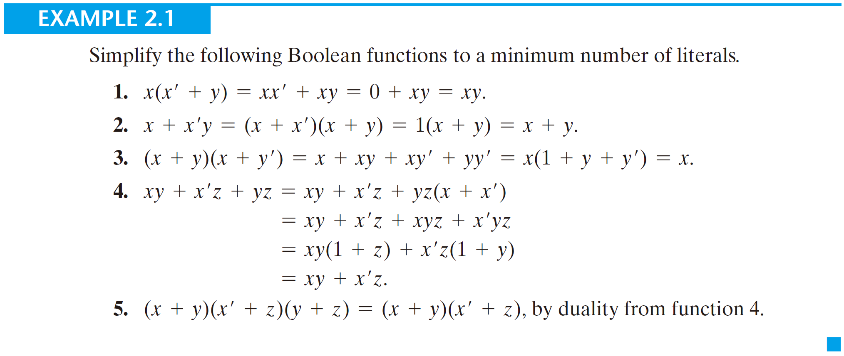
Algebraic Manipulation

Slide 76
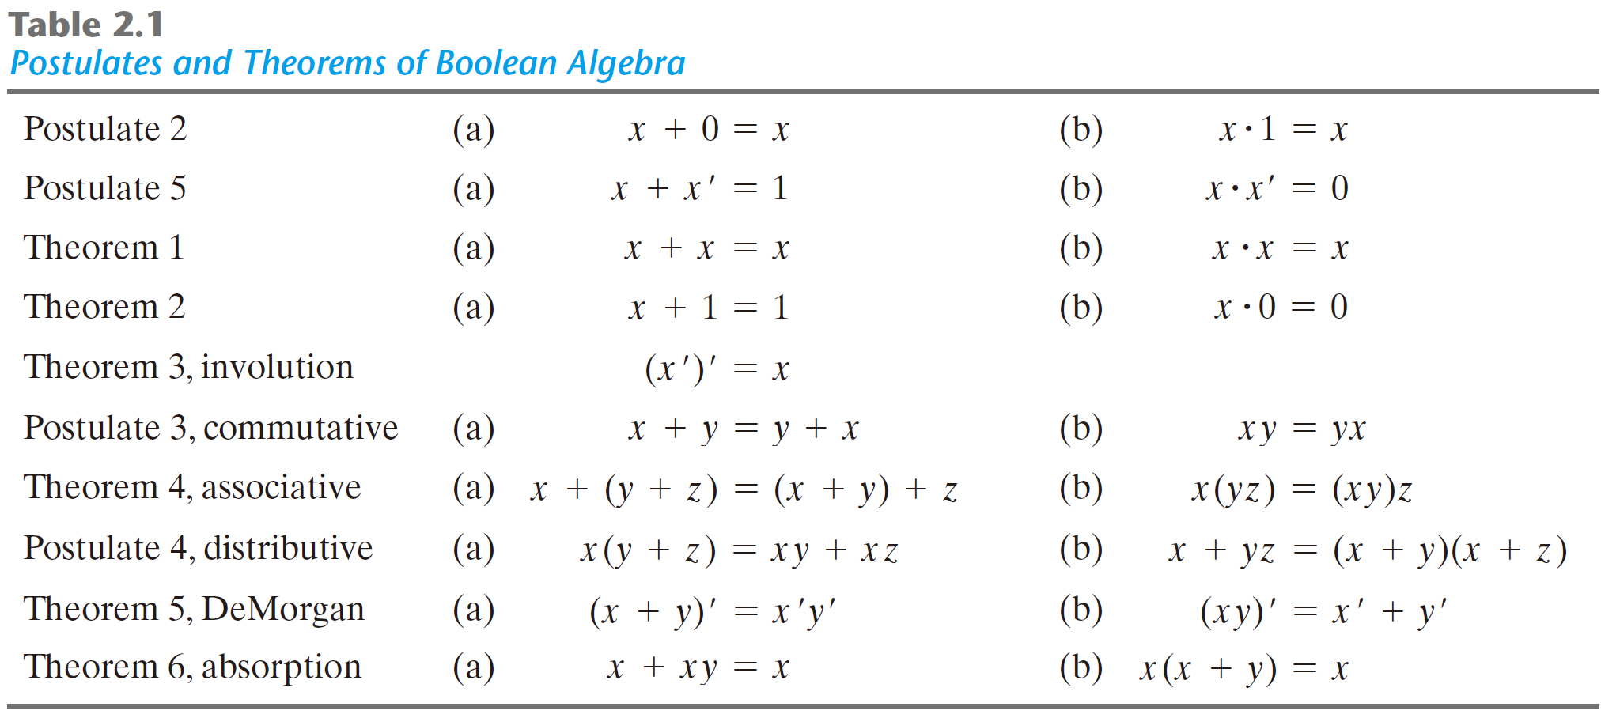

Slide 77
Boolean
Function
Equivalence
True
Table
Logic
Circuit

Slide 78
Boolean
Function
Equivalence
True
Table
Logic
Circuit

Slide 79
Boolean
Function
Equivalence
True
Table
Logic
Circuit

Slide 80
Boolean
Function
?
Equivalence
True
Table
Logic
Circuit
?

Slide 81
Boolean
Function
?
Equivalence
x
True
Table
Logic
Circuit
?

Slide 82
Boolean
Function
Equivalence
True
Table
Logic
Circuit

Slide 83
Boolean
Function
?
Equivalence
True
Table
Logic
Circuit

Slide 84
Complement of a Function
  F₁= x + y’ z
x | y | z | F₁
0 | 0 | 0 | 0
0 | 0 | 1 | 1
0 | 1 | 0 | 0
0 | 1 | 1 | 0
1 | 0 | 0 | 1
1 | 0 | 1 | 1
1 | 1 | 0 | 1
1 | 1 | 1 | 1
x | y | z | F₁
0 | 0 | 0 | 0
0 | 0 | 1 | 1
0 | 1 | 0 | 0
0 | 1 | 1 | 0
1 | 0 | 0 | 1
1 | 0 | 1 | 1
1 | 1 | 0 | 1
1 | 1 | 1 | 1

Slide 85
Complement of a Function
  F₁= x + y’ z
x | y | z | F₁ | F₁’
0 | 0 | 0 | 0
0 | 0 | 1 | 1
0 | 1 | 0 | 0
0 | 1 | 1 | 0
1 | 0 | 0 | 1
1 | 0 | 1 | 1
1 | 1 | 0 | 1
1 | 1 | 1 | 1
x | y | z | F₁
0 | 0 | 0 | 0
0 | 0 | 1 | 1
0 | 1 | 0 | 0
0 | 1 | 1 | 0
1 | 0 | 0 | 1
1 | 0 | 1 | 1
1 | 1 | 0 | 1
1 | 1 | 1 | 1

Slide 86
Complement of a Function
  F₁= x + y’ z
x | y | z | F₁ | F₁’
0 | 0 | 0 | 0
0 | 0 | 1 | 1
0 | 1 | 0 | 0
0 | 1 | 1 | 0
1 | 0 | 0 | 1
1 | 0 | 1 | 1
1 | 1 | 0 | 1
1 | 1 | 1 | 1
  Interchange of 0's for 1's and 1's for 0's in the value of F₁
x | y | z | F₁
0 | 0 | 0 | 0
0 | 0 | 1 | 1
0 | 1 | 0 | 0
0 | 1 | 1 | 0
1 | 0 | 0 | 1
1 | 0 | 1 | 1
1 | 1 | 0 | 1
1 | 1 | 1 | 1

Slide 87
Complement of a Function
  F₁= x + y’ z
x | y | z | F₁ | F₁’
0 | 0 | 0 | 0 | 1
0 | 0 | 1 | 1 | 0
0 | 1 | 0 | 0 | 1
0 | 1 | 1 | 0 | 1
1 | 0 | 0 | 1 | 0
1 | 0 | 1 | 1 | 0
1 | 1 | 0 | 1 | 0
1 | 1 | 1 | 1 | 0
  Interchange of 0's for 1's and 1's for 0's in the value of F₁
x | y | z | F₁
0 | 0 | 0 | 0
0 | 0 | 1 | 1
0 | 1 | 0 | 0
0 | 1 | 1 | 0
1 | 0 | 0 | 1
1 | 0 | 1 | 1
1 | 1 | 0 | 1
1 | 1 | 1 | 1

Slide 88
Complement of a Function
  F₁= x + y’ z
x | y | z | F₁ | F₁’
0 | 0 | 0 | 0 | 1
0 | 0 | 1 | 1 | 0
0 | 1 | 0 | 0 | 1
0 | 1 | 1 | 0 | 1
1 | 0 | 0 | 1 | 0
1 | 0 | 1 | 1 | 0
1 | 1 | 0 | 1 | 0
1 | 1 | 1 | 1 | 0
  How to derive the Boolean function of F₁’?
x | y | z | F₁
0 | 0 | 0 | 0
0 | 0 | 1 | 1
0 | 1 | 0 | 0
0 | 1 | 1 | 0
1 | 0 | 0 | 1
1 | 0 | 1 | 1
1 | 1 | 0 | 1
1 | 1 | 1 | 1

Slide 89
Complement of a Function
  F₁= x + y’ z
x | y | z | F₁ | F₁’
0 | 0 | 0 | 0 | 1
0 | 0 | 1 | 1 | 0
0 | 1 | 0 | 0 | 1
0 | 1 | 1 | 0 | 1
1 | 0 | 0 | 1 | 0
1 | 0 | 1 | 1 | 0
1 | 1 | 0 | 1 | 0
1 | 1 | 1 | 1 | 0
  How to derive the Boolean function of F₁’?
x | y | z | F₁
0 | 0 | 0 | 0
0 | 0 | 1 | 1
0 | 1 | 0 | 0
0 | 1 | 1 | 0
1 | 0 | 0 | 1
1 | 0 | 1 | 1
1 | 1 | 0 | 1
1 | 1 | 1 | 1
  by DeMorgan's theorem

Slide 90
Complement of a Function
  F₁= x + y’ z
  F₁’ = (x + y’ z)’
x | y | z | F₁ | F₁’
0 | 0 | 0 | 0 | 1
0 | 0 | 1 | 1 | 0
0 | 1 | 0 | 0 | 1
0 | 1 | 1 | 0 | 1
1 | 0 | 0 | 1 | 0
1 | 0 | 1 | 1 | 0
1 | 1 | 0 | 1 | 0
1 | 1 | 1 | 1 | 0
x | y | z | F₁
0 | 0 | 0 | 0
0 | 0 | 1 | 1
0 | 1 | 0 | 0
0 | 1 | 1 | 0
1 | 0 | 0 | 1
1 | 0 | 1 | 1
1 | 1 | 0 | 1
1 | 1 | 1 | 1

Slide 91
Complement of a Function
  F₁= x + y’ z
  F₁’ = (x + y’ z)’
  = x’ · (y’ z)’
x | y | z | F₁ | F₁’
0 | 0 | 0 | 0 | 1
0 | 0 | 1 | 1 | 0
0 | 1 | 0 | 0 | 1
0 | 1 | 1 | 0 | 1
1 | 0 | 0 | 1 | 0
1 | 0 | 1 | 1 | 0
1 | 1 | 0 | 1 | 0
1 | 1 | 1 | 1 | 0
x | y | z | F₁
0 | 0 | 0 | 0
0 | 0 | 1 | 1
0 | 1 | 0 | 0
0 | 1 | 1 | 0
1 | 0 | 0 | 1
1 | 0 | 1 | 1
1 | 1 | 0 | 1
1 | 1 | 1 | 1

Slide 92
Complement of a Function
  F₁= x + y’ z
  F₁’ = (x + y’ z)’
  = x’ · (y’ z)’
  = x’ · (y + z’)
x | y | z | F₁ | F₁’
0 | 0 | 0 | 0 | 1
0 | 0 | 1 | 1 | 0
0 | 1 | 0 | 0 | 1
0 | 1 | 1 | 0 | 1
1 | 0 | 0 | 1 | 0
1 | 0 | 1 | 1 | 0
1 | 1 | 0 | 1 | 0
1 | 1 | 1 | 1 | 0
x | y | z | F₁
0 | 0 | 0 | 0
0 | 0 | 1 | 1
0 | 1 | 0 | 0
0 | 1 | 1 | 0
1 | 0 | 0 | 1
1 | 0 | 1 | 1
1 | 1 | 0 | 1
1 | 1 | 1 | 1

Slide 93
Complement of a Function
  F₁= x + y’ z
  F₁’ = (x + y’ z)’
  = x’ · (y’ z)’
  = x’ · (y + z’)
  = x’ y + x’ z’
x | y | z | F₁ | F₁’
0 | 0 | 0 | 0 | 1
0 | 0 | 1 | 1 | 0
0 | 1 | 0 | 0 | 1
0 | 1 | 1 | 0 | 1
1 | 0 | 0 | 1 | 0
1 | 0 | 1 | 1 | 0
1 | 1 | 0 | 1 | 0
1 | 1 | 1 | 1 | 0
x | y | z | F₁
0 | 0 | 0 | 0
0 | 0 | 1 | 1
0 | 1 | 0 | 0
0 | 1 | 1 | 0
1 | 0 | 0 | 1
1 | 0 | 1 | 1
1 | 1 | 0 | 1
1 | 1 | 1 | 1

Slide 94
  Generalization of DeMorgan's theorem
  (A + B + C)’ = (A + X)’ let B + C = X
  = A’ X’ by DeMorgan's
  = A’ (B + C)’
  = A’ (B’ C’) by DeMorgan's
  = A’ B’ C‘
generalizations
  (A + B + C + ... + F)’ = A’ B’ C’ ... F’
  (A B C ... F)’ = A’ + B’ + C’ + ... + F’

Slide 95
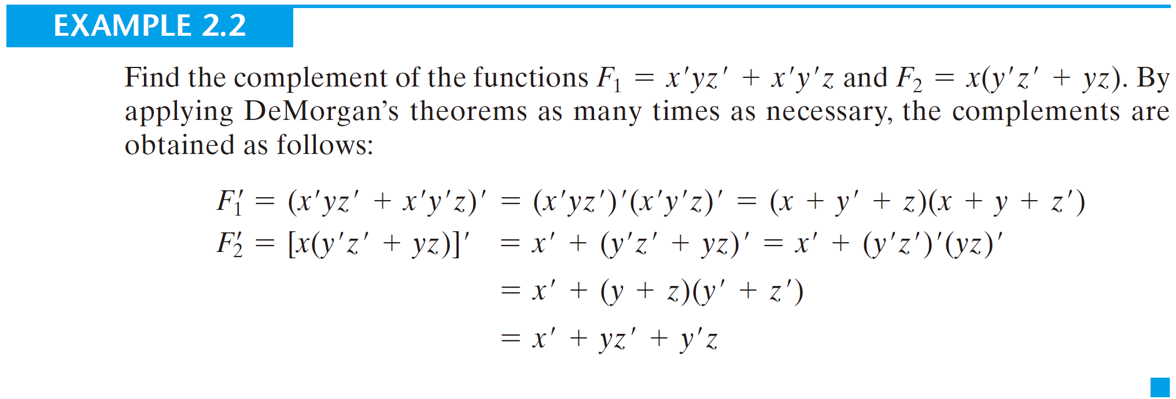
  Generalization of DeMorgan's theorem

Slide 96
  Generalization of DeMorgan's theorem
Find the complement of the Boolean function F = A’ B C’ + A’ B’ C.

Slide 97
  Generalization of DeMorgan's theorem
Find the complement of the Boolean function F = A’ B C’ + A’ B’ C.
F’ = (A’ B C’ + A’ B’ C)’

Slide 98
  Generalization of DeMorgan's theorem
Find the complement of the Boolean function F = A’ B C’ + A’ B’ C.
F’ = (A’ B C’ + A’ B’ C)’
= (A’ B C’)’ · (A’ B’ C)’

Slide 99
  Generalization of DeMorgan's theorem
Find the complement of the Boolean function F = A’ B C’ + A’ B’ C.
F’ = (A’ B C’ + A’ B’ C)’
= (A’ B C’)’ · (A’ B’ C)’
= (A + B’ + C) · (A + B + C’)

Slide 100
  Generalization of DeMorgan's theorem
Find the complement of the Boolean function F = A’ B C’ + A’ B’ C.
F’ = (A’ B C’ + A’ B’ C)’
= (A’ B C’)’ · (A’ B’ C)’
= (A + B’ + C) · (A + B + C’)
= A + A B + A C’ + A B’ + B’C’ + A C + B C

Slide 101
  Generalization of DeMorgan's theorem
Find the complement of the Boolean function F = A’ B C’ + A’ B’ C.
F’ = (A’ B C’ + A’ B’ C)’
= (A’ B C’)’ · (A’ B’ C)’
= (A + B’ + C) · (A + B + C’)
= A + A B + A C’ + A B’ + B’C’ + A C + B C
= A + B’ C’ + B C

Slide 102
Canonical and Standard Forms

Slide 103
Minterms
  A minterm: an AND term consists of all literals in their normal form or in their complement form
  For example, two binary variables x and y,
    xy, xy’, x’y, x’y’
  It is also called a standard product
  n variables can be combined to form 2^{n} minterms

Slide 104
  F₂ (x, y) = x + x’ y + x y’ + y
  F₂ (x, y ,z) = x’ y’ z + x z + x’ y z + x y’

Slide 105
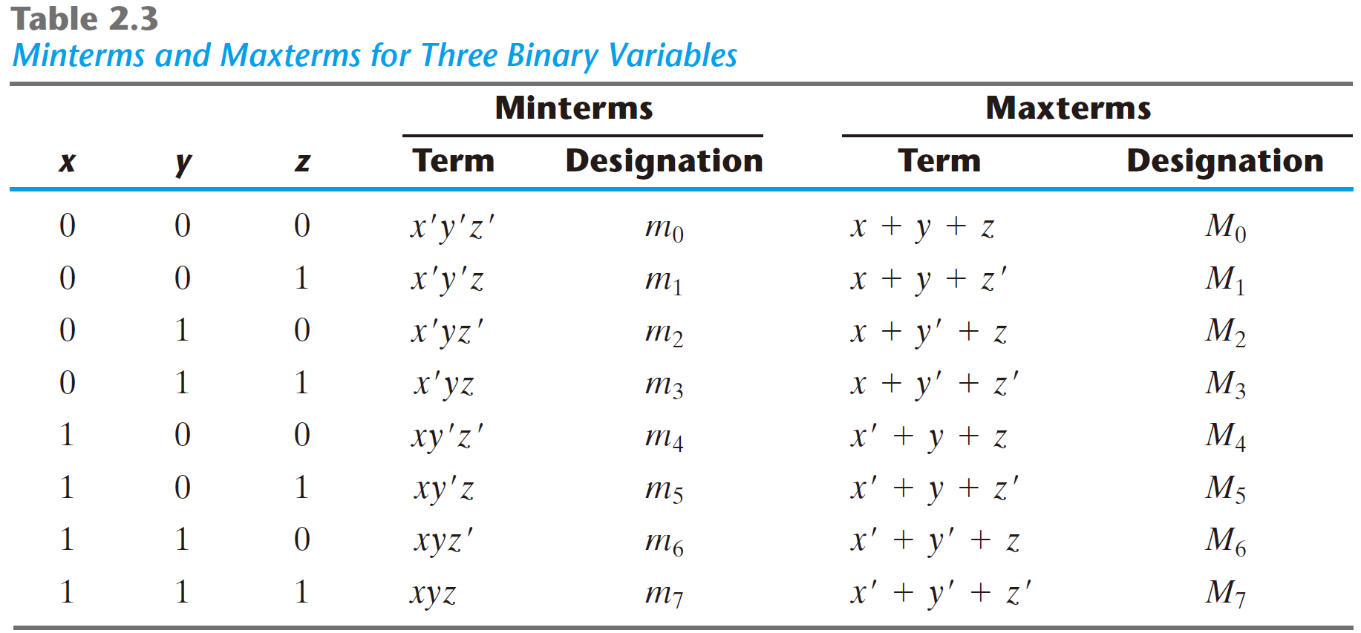

Slide 106
Derive Boolean function from true table
A Boolean function can be expressed algebraically from a given truth table by forming a minterm for each combination of the variables that produces a 1 in the function and then taking the OR of all those terms.

Slide 107
Derive Boolean function from true table
x | y | z | F₁
0 | 0 | 0 | 0
0 | 0 | 1 | 1
0 | 1 | 0 | 0
0 | 1 | 1 | 0
1 | 0 | 0 | 1
1 | 0 | 1 | 0
1 | 1 | 0 | 0
1 | 1 | 1 | 1
  F₁ =

Slide 108
Derive Boolean function from true table
x | y | z | F₁
0 | 0 | 0 | 0
0 | 0 | 1 | 1
0 | 1 | 0 | 0
0 | 1 | 1 | 0
1 | 0 | 0 | 1
1 | 0 | 1 | 0
1 | 1 | 0 | 0
1 | 1 | 1 | 1
  F₁ = x'y'z

Slide 109
Derive Boolean function from true table
x | y | z | F₁
0 | 0 | 0 | 0
0 | 0 | 1 | 1
0 | 1 | 0 | 0
0 | 1 | 1 | 0
1 | 0 | 0 | 1
1 | 0 | 1 | 0
1 | 1 | 0 | 0
1 | 1 | 1 | 1
  F₁ = x'y'z + xy'z'

Slide 110
Derive Boolean function from true table
x | y | z | F₁
0 | 0 | 0 | 0
0 | 0 | 1 | 1
0 | 1 | 0 | 0
0 | 1 | 1 | 0
1 | 0 | 0 | 1
1 | 0 | 1 | 0
1 | 1 | 0 | 0
1 | 1 | 1 | 1
  F₁ = x'y'z + xy'z' + xyz

Slide 111
Derive Boolean function from true table
x | y | z | F₁
0 | 0 | 0 | 0
0 | 0 | 1 | 1
0 | 1 | 0 | 0
0 | 1 | 1 | 0
1 | 0 | 0 | 1
1 | 0 | 1 | 0
1 | 1 | 0 | 0
1 | 1 | 1 | 1
  F₁ = x'y'z + xy'z' + xyz

Slide 112
Derive Boolean function from true table
x | y | z | F₁
0 | 0 | 0 | 0
0 | 0 | 1 | 1
0 | 1 | 0 | 0
0 | 1 | 1 | 0
1 | 0 | 0 | 1
1 | 0 | 1 | 0
1 | 1 | 0 | 0
1 | 1 | 1 | 1
  Sum of minterms
  F₁ = x'y'z + xy'z' + xyz

Slide 113
Derive Boolean function from true table
x | y | z | F₁
0 | 0 | 0 | 0
0 | 0 | 1 | 1
0 | 1 | 0 | 0
0 | 1 | 1 | 0
1 | 0 | 0 | 1
1 | 0 | 1 | 0
1 | 1 | 0 | 0
1 | 1 | 1 | 1
  Sum of minterms
  F₁ = x'y'z + xy'z' + xyz
  = m₁ + m₄ + m₇

Slide 114
Derive Boolean function from true table
x | y | z | F₁
0 | 0 | 0 | 0
0 | 0 | 1 | 1
0 | 1 | 0 | 0
0 | 1 | 1 | 0
1 | 0 | 0 | 1
1 | 0 | 1 | 0
1 | 1 | 0 | 0
1 | 1 | 1 | 1
  Sum of minterms
  F₁ = x'y'z + xy'z' + xyz
  = m₁ + m₄ + m₇
  = ∑(1, 4, 7)

Slide 115
Derive Boolean function from true table
x | y | z | F₂
0 | 0 | 0 | 0
0 | 0 | 1 | 0
0 | 1 | 0 | 0
0 | 1 | 1 | 1
1 | 0 | 0 | 0
1 | 0 | 1 | 1
1 | 1 | 0 | 1
1 | 1 | 1 | 1
  F₂ =

Slide 116
Derive Boolean function from true table
x | y | z | F₂
0 | 0 | 0 | 0
0 | 0 | 1 | 0
0 | 1 | 0 | 0
0 | 1 | 1 | 1
1 | 0 | 0 | 0
1 | 0 | 1 | 1
1 | 1 | 0 | 1
1 | 1 | 1 | 1
  F₂ =

Slide 117
Derive Boolean function from true table
x | y | z | F₂
0 | 0 | 0 | 0
0 | 0 | 1 | 0
0 | 1 | 0 | 0
0 | 1 | 1 | 1
1 | 0 | 0 | 0
1 | 0 | 1 | 1
1 | 1 | 0 | 1
1 | 1 | 1 | 1
  F₂ = x'yz + xy'z + xyz‘ + xyz

Slide 118
Derive Boolean function from true table
x | y | z | F₂
0 | 0 | 0 | 0
0 | 0 | 1 | 0
0 | 1 | 0 | 0
0 | 1 | 1 | 1
1 | 0 | 0 | 0
1 | 0 | 1 | 1
1 | 1 | 0 | 1
1 | 1 | 1 | 1
  Sum of minterms
  F₂ = x'yz + xy'z + xyz‘ + xyz

Slide 119
Derive Boolean function from true table
x | y | z | F₂
0 | 0 | 0 | 0
0 | 0 | 1 | 0
0 | 1 | 0 | 0
0 | 1 | 1 | 1
1 | 0 | 0 | 0
1 | 0 | 1 | 1
1 | 1 | 0 | 1
1 | 1 | 1 | 1
  Sum of minterms
  F₂ = x'yz + xy'z + xyz‘ + xyz
  = m₃ + m₅ + m₆ + m₇

Slide 120
Derive Boolean function from true table
x | y | z | F₂
0 | 0 | 0 | 0
0 | 0 | 1 | 0
0 | 1 | 0 | 0
0 | 1 | 1 | 1
1 | 0 | 0 | 0
1 | 0 | 1 | 1
1 | 1 | 0 | 1
1 | 1 | 1 | 1
  Sum of minterms
  F₂ = x'yz + xy'z + xyz‘ + xyz
  = m₃ + m₅ + m₆ + m₇
  = ∑(3, 5, 6, 7)

Slide 121
Maxterms
  A maxterm: an OR term consists of all literals in their normal form or in their complement form
  For example, two binary variables x and y,
    x + y, x + y’, x’ + y, x’ + y’
  It is also call a standard sum
  n variables can be combined to form 2^{n} maxterms

Slide 122
  F₂ (x, y) = x · (x’ + y) · (x + y’) · y
  F₂ (x, y ,z) = (x’ + y’ + z ) · (x + z) · (x’ + y + z)

Slide 123
  Each maxterm is the complement of its corresponding minterm, and vice versa.

Slide 124
Derive Boolean function from true table
x | y | z | F₁ | F₁’
0 | 0 | 0 | 0 | 1
0 | 0 | 1 | 1 | 0
0 | 1 | 0 | 0 | 1
0 | 1 | 1 | 0 | 1
1 | 0 | 0 | 1 | 0
1 | 0 | 1 | 0 | 1
1 | 1 | 0 | 0 | 1
1 | 1 | 1 | 1 | 0
F₁ =

Slide 125
Derive Boolean function from true table
x | y | z | F₁ | F₁’
0 | 0 | 0 | 0 | 1
0 | 0 | 1 | 1 | 0
0 | 1 | 0 | 0 | 1
0 | 1 | 1 | 0 | 1
1 | 0 | 0 | 1 | 0
1 | 0 | 1 | 0 | 1
1 | 1 | 0 | 0 | 1
1 | 1 | 1 | 1 | 0
F₁ = x’y’z + xy’z’ + xyz

Slide 126
Derive Boolean function from true table
x | y | z | F₁ | F₁’
0 | 0 | 0 | 0 | 1
0 | 0 | 1 | 1 | 0
0 | 1 | 0 | 0 | 1
0 | 1 | 1 | 0 | 1
1 | 0 | 0 | 1 | 0
1 | 0 | 1 | 0 | 1
1 | 1 | 0 | 0 | 1
1 | 1 | 1 | 1 | 0
F₁ = x’y’z + xy’z’ + xyz
= m₁ + m₄ + m₇

Slide 127
Derive Boolean function from true table
x | y | z | F₁ | F₁’
0 | 0 | 0 | 0 | 1
0 | 0 | 1 | 1 | 0
0 | 1 | 0 | 0 | 1
0 | 1 | 1 | 0 | 1
1 | 0 | 0 | 1 | 0
1 | 0 | 1 | 0 | 1
1 | 1 | 0 | 0 | 1
1 | 1 | 1 | 1 | 0
F₁ = x’y’z + xy’z’ + xyz
= m₁ + m₄ + m₇
= ∑(1, 4 , 7)
  Sum of minterms

Slide 128
Derive Boolean function from true table
x | y | z | F₁ | F₁’
0 | 0 | 0 | 0 | 1
0 | 0 | 1 | 1 | 0
0 | 1 | 0 | 0 | 1
0 | 1 | 1 | 0 | 1
1 | 0 | 0 | 1 | 0
1 | 0 | 1 | 0 | 1
1 | 1 | 0 | 0 | 1
1 | 1 | 1 | 1 | 0
F₁’ = x’y’z’ + x’yz’ + x’yz + xy’z +xyz’

Slide 129
Derive Boolean function from true table
x | y | z | F₁ | F₁’
0 | 0 | 0 | 0 | 1
0 | 0 | 1 | 1 | 0
0 | 1 | 0 | 0 | 1
0 | 1 | 1 | 0 | 1
1 | 0 | 0 | 1 | 0
1 | 0 | 1 | 0 | 1
1 | 1 | 0 | 0 | 1
1 | 1 | 1 | 1 | 0
F₁’ = x’y’z’ + x’yz’ + x’yz + xy’z +xyz’
By DeMorgan's theorem

Slide 130
Derive Boolean function from true table
x | y | z | F₁ | F₁’
0 | 0 | 0 | 0 | 1
0 | 0 | 1 | 1 | 0
0 | 1 | 0 | 0 | 1
0 | 1 | 1 | 0 | 1
1 | 0 | 0 | 1 | 0
1 | 0 | 1 | 0 | 1
1 | 1 | 0 | 0 | 1
1 | 1 | 1 | 1 | 0
F₁’ = x’y’z’ + x’yz’ + x’yz + xy’z +xyz’
By DeMorgan's theorem
F₁ = (x’y’z’ + x’yz’ + x’yz + xy’z +xyz’)’

Slide 131
Derive Boolean function from true table
x | y | z | F₁ | F₁’
0 | 0 | 0 | 0 | 1
0 | 0 | 1 | 1 | 0
0 | 1 | 0 | 0 | 1
0 | 1 | 1 | 0 | 1
1 | 0 | 0 | 1 | 0
1 | 0 | 1 | 0 | 1
1 | 1 | 0 | 0 | 1
1 | 1 | 1 | 1 | 0
F₁’ = x’y’z’ + x’yz’ + x’yz + xy’z +xyz’
By DeMorgan's theorem
F₁ = (x’y’z’ + x’yz’ + x’yz + xy’z +xyz’)’
= (x + y + z)(x + y’ + z)(x + y’ + z’)
(x’ + y + z’)(x’ + y’ + z)

Slide 132
Derive Boolean function from true table
x | y | z | F₁ | F₁’
0 | 0 | 0 | 0 | 1
0 | 0 | 1 | 1 | 0
0 | 1 | 0 | 0 | 1
0 | 1 | 1 | 0 | 1
1 | 0 | 0 | 1 | 0
1 | 0 | 1 | 0 | 1
1 | 1 | 0 | 0 | 1
1 | 1 | 1 | 1 | 0
F₁’ = x’y’z’ + x’yz’ + x’yz + xy’z +xyz’
By DeMorgan's theorem
F₁ = (x’y’z’ + x’yz’ + x’yz + xy’z +xyz’)’
= (x + y + z)(x + y’ + z)(x + y’ + z’)
(x’ + y + z’)(x’ + y’ + z)
= M₀ · M₂ · M₃ · M₅ · M₆

Slide 133
Derive Boolean function from true table
x | y | z | F₁ | F₁’
0 | 0 | 0 | 0 | 1
0 | 0 | 1 | 1 | 0
0 | 1 | 0 | 0 | 1
0 | 1 | 1 | 0 | 1
1 | 0 | 0 | 1 | 0
1 | 0 | 1 | 0 | 1
1 | 1 | 0 | 0 | 1
1 | 1 | 1 | 1 | 0
F₁’ = x’y’z’ + x’yz’ + x’yz + xy’z +xyz’
By DeMorgan's theorem
F₁ = (x’y’z’ + x’yz’ + x’yz + xy’z +xyz’)’
= (x + y + z)(x + y’ + z)(x + y’ + z’)
(x’ + y + z’)(x’ + y’ + z)
= M₀ · M₂ · M₃ · M₅ · M₆
= ∏ (0, 2, 3, 5, 6)

Slide 134
Derive Boolean function from true table
x | y | z | F₁ | F₁’
0 | 0 | 0 | 0 | 1
0 | 0 | 1 | 1 | 0
0 | 1 | 0 | 0 | 1
0 | 1 | 1 | 0 | 1
1 | 0 | 0 | 1 | 0
1 | 0 | 1 | 0 | 1
1 | 1 | 0 | 0 | 1
1 | 1 | 1 | 1 | 0
F₁’ = x’y’z’ + x’yz’ + x’yz + xy’z +xyz’
By DeMorgan's theorem
F₁ = (x’y’z’ + x’yz’ + x’yz + xy’z +xyz’)’
= (x + y + z)(x + y’ + z)(x + y’ + z’)
(x’ + y + z’)(x’ + y’ + z)
= M₀ · M₂ · M₃ · M₄ · M₆
= ∏ (0, 2, 3, 5, 6)
  Product of Maxterms

Slide 135
Derive Boolean function from true table
x | y | z | F₁ | F₁’
0 | 0 | 0 | 0 | 1
0 | 0 | 1 | 1 | 0
0 | 1 | 0 | 0 | 1
0 | 1 | 1 | 0 | 1
1 | 0 | 0 | 1 | 0
1 | 0 | 1 | 0 | 1
1 | 1 | 0 | 0 | 1
1 | 1 | 1 | 1 | 0
F₁ = ∑(1, 4 , 7) = ∏ (0, 2, 3, 5, 6)

Slide 136
Derive Boolean function from true table
x | y | z | F₁ | F₁’
0 | 0 | 0 | 0 | 1
0 | 0 | 1 | 1 | 0
0 | 1 | 0 | 0 | 1
0 | 1 | 1 | 0 | 1
1 | 0 | 0 | 1 | 0
1 | 0 | 1 | 0 | 1
1 | 1 | 0 | 0 | 1
1 | 1 | 1 | 1 | 0
F₁ = ∑(1, 4 , 7) = ∏ (0, 2, 3, 5, 6)
Boolean functions
expressed as a sum of minterms or product of maxterms are said to be in canonical form.

Slide 137
Derive Boolean function from true table
x | y | z | F₁ | F₁’
0 | 0 | 0 | 0 | 1
0 | 0 | 1 | 1 | 0
0 | 1 | 0 | 0 | 1
0 | 1 | 1 | 0 | 1
1 | 0 | 0 | 1 | 0
1 | 0 | 1 | 0 | 1
1 | 1 | 0 | 0 | 1
1 | 1 | 1 | 1 | 0
F₁ = ∑(1, 4 , 7)

Slide 138
Derive Boolean function from true table
x | y | z | F₁ | F₁’
0 | 0 | 0 | 0 | 1
0 | 0 | 1 | 1 | 0
0 | 1 | 0 | 0 | 1
0 | 1 | 1 | 0 | 1
1 | 0 | 0 | 1 | 0
1 | 0 | 1 | 0 | 1
1 | 1 | 0 | 0 | 1
1 | 1 | 1 | 1 | 0
F₁ = ∑(1, 4 , 7)
F₁’ = ∑(0, 2 , 3, 5, 6)

Slide 139
Derive Boolean function from true table
x | y | z | F₁ | F₁’
0 | 0 | 0 | 0 | 1
0 | 0 | 1 | 1 | 0
0 | 1 | 0 | 0 | 1
0 | 1 | 1 | 0 | 1
1 | 0 | 0 | 1 | 0
1 | 0 | 1 | 0 | 1
1 | 1 | 0 | 0 | 1
1 | 1 | 1 | 1 | 0
F₁ = ∑(1, 4 , 7)
F₁’ = ∑(0, 2 , 3, 5, 6)
= m₀ + m₂ + m₃ + m₅ + m₆

Slide 140
Derive Boolean function from true table
x | y | z | F₁ | F₁’
0 | 0 | 0 | 0 | 1
0 | 0 | 1 | 1 | 0
0 | 1 | 0 | 0 | 1
0 | 1 | 1 | 0 | 1
1 | 0 | 0 | 1 | 0
1 | 0 | 1 | 0 | 1
1 | 1 | 0 | 0 | 1
1 | 1 | 1 | 1 | 0
F₁ = ∑(1, 4 , 7)
F₁’ = ∑(0, 2 , 3, 5, 6)
= m₀ + m₂ + m₃ + m₅ + m₆
F₁ = (m₀ + m₂ + m₃ + m₅ + m₆)’

Slide 141
Derive Boolean function from true table
x | y | z | F₁ | F₁’
0 | 0 | 0 | 0 | 1
0 | 0 | 1 | 1 | 0
0 | 1 | 0 | 0 | 1
0 | 1 | 1 | 0 | 1
1 | 0 | 0 | 1 | 0
1 | 0 | 1 | 0 | 1
1 | 1 | 0 | 0 | 1
1 | 1 | 1 | 1 | 0
F₁ = ∑(1, 4 , 7)
F₁’ = ∑(0, 2 , 3, 5, 6)
= m₀ + m₂ + m₃ + m₅ + m₆
F₁ = (m₀ + m₂ + m₃ + m₅ + m₆)’
= M₀ · M₂ · M₃ · M₅ · M₆

Slide 142
Derive Boolean function from true table
x | y | z | F₁ | F₁’
0 | 0 | 0 | 0 | 1
0 | 0 | 1 | 1 | 0
0 | 1 | 0 | 0 | 1
0 | 1 | 1 | 0 | 1
1 | 0 | 0 | 1 | 0
1 | 0 | 1 | 0 | 1
1 | 1 | 0 | 0 | 1
1 | 1 | 1 | 1 | 0
F₁ = ∑(1, 4 , 7)
F₁’ = ∑(0, 2 , 3, 5, 6)
= m₀ + m₂ + m₃ + m₅ + m₆
F₁ = (m₀ + m₂ + m₃ + m₅ + m₆)’
= M₀ · M₂ · M₃ · M₅ · M₆
= ∏ (0, 2, 3, 4, 6)

Slide 143
Derive Boolean function from true table
  Converter the Boolean function F = xy + x′z to Canonical Forms.

Slide 144
Derive Boolean function from true table
  Converter the Boolean function F = xy + x′z to Canonical Forms.
x | y | z | F
0 | 0 | 0 | 0
0 | 0 | 1 | 1
0 | 1 | 0 | 0
0 | 1 | 1 | 1
1 | 0 | 0 | 0
1 | 0 | 1 | 0
1 | 1 | 0 | 1
1 | 1 | 1 | 1

Slide 145
Derive Boolean function from true table
  Converter the Boolean function F = xy + x′z to Canonical Forms.
x | y | z | F
0 | 0 | 0 | 0
0 | 0 | 1 | 1
0 | 1 | 0 | 0
0 | 1 | 1 | 1
1 | 0 | 0 | 0
1 | 0 | 1 | 0
1 | 1 | 0 | 1
1 | 1 | 1 | 1
Minterms

Slide 146
Derive Boolean function from true table
  Converter the Boolean function F = xy + x′z to Canonical Forms.
x | y | z | F
0 | 0 | 0 | 0
0 | 0 | 1 | 1
0 | 1 | 0 | 0
0 | 1 | 1 | 1
1 | 0 | 0 | 0
1 | 0 | 1 | 0
1 | 1 | 0 | 1
1 | 1 | 1 | 1
F = ∑(1, 3 , 6, 7)
Minterms

Slide 147
Derive Boolean function from true table
  Converter the Boolean function F = xy + x′z to Canonical Forms.
x | y | z | F
0 | 0 | 0 | 0
0 | 0 | 1 | 1
0 | 1 | 0 | 0
0 | 1 | 1 | 1
1 | 0 | 0 | 0
1 | 0 | 1 | 0
1 | 1 | 0 | 1
1 | 1 | 1 | 1
Maxterms
F = ∑(1, 3 , 6, 7)
Minterms

Slide 148
Derive Boolean function from true table
  Converter the Boolean function F = xy + x′z to Canonical Forms.
x | y | z | F
0 | 0 | 0 | 0
0 | 0 | 1 | 1
0 | 1 | 0 | 0
0 | 1 | 1 | 1
1 | 0 | 0 | 0
1 | 0 | 1 | 0
1 | 1 | 0 | 1
1 | 1 | 1 | 1
Maxterms
F = ∏ (0, 2, 4, 5)
F = ∑(1, 3 , 6, 7)
Minterms

Slide 149
Any Boolean function can be expressed as
    a sum of minterms
    a product of maxterms
    canonical form

Slide 150
Express the Boolean function F = A + B’C as a sum of minterms
  F = A + B'C

Slide 151
Express the Boolean function F = A + B’C as a sum of minterms
A | B | C | F
0 | 0 | 0 | 0
0 | 0 | 1 | 1
0 | 1 | 0 | 0
0 | 1 | 1 | 0
1 | 0 | 0 | 1
1 | 0 | 1 | 1
1 | 1 | 0 | 1
1 | 1 | 1 | 1
  F = A + B'C

Slide 152
Express the Boolean function F = A + B’C as a sum of minterms
  F = A + B'C
  = ∑ (1, 4, 5, 6, 7)
A | B | C | F
0 | 0 | 0 | 0
0 | 0 | 1 | 1
0 | 1 | 0 | 0
0 | 1 | 1 | 0
1 | 0 | 0 | 1
1 | 0 | 1 | 1
1 | 1 | 0 | 1
1 | 1 | 1 | 1

Slide 153
Express the Boolean function F = A + B’C as a sum of minterms
  F = A + B'C

Slide 154
Express the Boolean function F = A + B’C as a sum of minterms
  F = A + B'C
  = A (B + B') + B'C

Slide 155
Express the Boolean function F = A + B’C as a sum of minterms
  F = A + B'C
  = A (B + B') + B'C
  = AB + AB' + B'C

Slide 156
Express the Boolean function F = A + B’C as a sum of minterms
  F = A + B'C
  = A (B + B') + B'C
  = AB + AB' + B'C
  = AB(C + C’) + AB’(C + C’) + (A + A’)B’C

Slide 157
Express the Boolean function F = A + B’C as a sum of minterms
  F = A + B'C
  = A (B + B') + B'C
  = AB + AB' + B'C
  = AB(C + C’) + AB’(C + C’) + (A + A’)B’C
  = ABC + ABC’ + AB’C + AB’C’ + AB’C + A’B’C

Slide 158
Express the Boolean function F = A + B’C as a sum of minterms
  F = A + B'C
  = A (B + B') + B'C
  = AB + AB' + B'C
  = AB(C + C’) + AB’(C + C’) + (A + A’)B’C
  = ABC + ABC’ + AB’C + AB’C’ + AB’C + A’B’C
  = ABC + ABC’ + AB’C + AB’C’ + AB’C + A’B’C
  = ABC + ABC’ + AB’C + AB’C’ + A’B’C

Slide 159
F = ABC + ABC’ + AB’C + AB’C’ + A’B’C
= m7 + m6 + m5 + m4 + m1
= ∑(1, 4 , 5 , 6 , 7)

Slide 160
F = ABC + ABC’ + AB’C + AB’C’ + A’B’C
= m7 + m6 + m5 + m4 + m1
= ∑(1, 4 , 5 , 6 , 7)
A | B | C | F
0 | 0 | 0
0 | 0 | 1
0 | 1 | 0
0 | 1 | 1
1 | 0 | 0
1 | 0 | 1
1 | 1 | 0
1 | 1 | 1

Slide 161
F = ABC + ABC’ + AB’C + AB’C’ + A’B’C
= m7 + m6 + m5 + m4 + m1
= ∑(1, 4 , 5 , 6 , 7)
A | B | C | F
0 | 0 | 0
0 | 0 | 1 | 1
0 | 1 | 0
0 | 1 | 1
1 | 0 | 0 | 1
1 | 0 | 1 | 1
1 | 1 | 0 | 1
1 | 1 | 1 | 1

Slide 162
F = ABC + ABC’ + AB’C + AB’C’ + A’B’C
= m7 + m6 + m5 + m4 + m1
= ∑(1, 4 , 5 , 6 , 7)
A | B | C | F
0 | 0 | 0 | 0
0 | 0 | 1 | 1
0 | 1 | 0 | 0
0 | 1 | 1 | 0
1 | 0 | 0 | 1
1 | 0 | 1 | 1
1 | 1 | 0 | 1
1 | 1 | 1 | 1

Slide 163
Express the Boolean function F = xy + x’z as a product of maxterms
  F = xy + x'z

Slide 164
Express the Boolean function F = xy + x’z as a product of maxterms
  F = xy + x'z
x | y | z | F
0 | 0 | 0 | 0
0 | 0 | 1 | 1
0 | 1 | 0 | 0
0 | 1 | 1 | 1
1 | 0 | 0 | 0
1 | 0 | 1 | 0
1 | 1 | 0 | 1
1 | 1 | 1 | 1

Slide 165
Express the Boolean function F = xy + x’z as a product of maxterms
  F = xy + x'z
  = ∏ (0, 2, 4, 5)
x | y | z | F
0 | 0 | 0 | 0
0 | 0 | 1 | 1
0 | 1 | 0 | 0
0 | 1 | 1 | 1
1 | 0 | 0 | 0
1 | 0 | 1 | 0
1 | 1 | 0 | 1
1 | 1 | 1 | 1

Slide 166
Express the Boolean function F = xy + x’z as a product of maxterms
  F = xy + x'z
  = (xy + x') (xy + z)

Slide 167
Express the Boolean function F = xy + x’z as a product of maxterms
  F = xy + x'z
  = (xy + x') (xy + z)
  = (x + x') (y + x') (x + z) (y + z)

Slide 168
Express the Boolean function F = xy + x’z as a product of maxterms
  F = xy + x'z
  = (xy + x') (xy + z)
  = (x + x') (y + x') (x + z) (y + z)
  = (x‘ + y) (x + z) (y + z)

Slide 169
Express the Boolean function F = xy + x’z as a product of maxterms
  F = xy + x'z
  = (xy + x') (xy + z)
  = (x + x') (y + x') (x + z) (y + z)
  = (x‘ + y) (x + z) (y + z)

Slide 170
  x’ + y
  = x’ + y + zz’
  = (x’ + y + z)(x’ + y + z’)

Slide 171
Express the Boolean function F = xy + x’z as a product of maxterms
  F = xy + x’z
  = (xy + x’)(xy + z)
  = (x + x’)(y + x’)(x + z)(y + z)
  = (x’ + y)(x + z)(y + z)

Slide 172
Express the Boolean function F = xy + x’z as a product of maxterms
  F = xy + x’z
  = (xy + x’)(xy + z)
  = (x + x’)(y + x’)(x + z)(y + z)
  = (x’ + y)(x + z)(y + z)
  = (x’ + y + zz’)(x + yy’ + z)(xx’ + y + z)

Slide 173
Express the Boolean function F = xy + x’z as a product of maxterms
  F = xy + x’z
  = (xy + x’)(xy + z)
  = (x + x’)(y + x’)(x + z)(y + z)
  = (x’ + y)(x + z)(y + z)
  = (x’ + y + zz’)(x + yy’ + z)(xx’ + y + z)
  = (x’ + y + z)(x’ + y + z’)(x + y + z)(x + y’ + z)
  (x + y + z)(x’ + y + z)

Slide 174
Express the Boolean function F = xy + x’z as a product of maxterms
  F = xy + x’z
  = (xy + x’)(xy + z)
  = (x + x’)(y + x’)(x + z)(y + z)
  = (x’ + y)(x + z)(y + z)
  = (x’ + y + zz’)(x + yy’ + z)(xx’ + y + z)
  = (x’ + y + z)(x’ + y + z’)(x + y + z)(x + y’ + z)
  (x + y + z)(x’ + y + z)

Slide 175
Express the Boolean function F = xy + x’z as a product of maxterms
  F = xy + x’z
  = (xy + x’)(xy + z)
  = (x + x’)(y + x’)(x + z)(y + z)
  = (x’ + y)(x + z)(y + z)
  = (x’ + y + zz’)(x + yy’ + z)(xx’ + y + z)
  = (x’ + y + z)(x’ + y + z’)(x + y + z)(x + y’ + z)

Slide 176
Express the Boolean function F = xy + x’z as a product of maxterms
  F = xy + x’z
  = (xy + x’)(xy + z)
  = (x + x’)(y + x’)(x + z)(y + z)
  = (x’ + y)(x + z)(y + z)
  = (x’ + y + zz’)(x + yy’ + z)(xx’ + y + z)
  = (x’ + y + z)(x’ + y + z’)(x + y + z)(x + y’ + z)
  = M₄ · M₅ · M₀ · M₂

Slide 177
Express the Boolean function F = xy + x’z as a product of maxterms
  F = xy + x’z
  = (xy + x’)(xy + z)
  = (x + x’)(y + x’)(x + z)(y + z)
  = (x’ + y)(x + z)(y + z)
  = (x’ + y + zz’)(x + yy’ + z)(xx’ + y + z)
  = (x’ + y + z)(x’ + y + z’)(x + y + z)(x + y’ + z)
  = M₄ · M₅ · M₀ · M₂
  = ∏ (0, 2, 4, 5)

Slide 178
  F = xy + x’z
  = ∏ (0, 2, 4, 5)

Slide 179
  F = xy + x’z
  = ∏ (0, 2, 4, 5)
A | B | C | F
0 | 0 | 0
0 | 0 | 1
0 | 1 | 0
0 | 1 | 1
1 | 0 | 0
1 | 0 | 1
1 | 1 | 0
1 | 1 | 1

Slide 180
  F = xy + x’z
  = ∏ (0, 2, 4, 5)
A | B | C | F
0 | 0 | 0 | 0
0 | 0 | 1
0 | 1 | 0 | 0
0 | 1 | 1
1 | 0 | 0 | 0
1 | 0 | 1 | 0
1 | 1 | 0
1 | 1 | 1

Slide 181
  F = xy + x’z
  = ∏ (0, 2, 4, 5)
A | B | C | F
0 | 0 | 0 | 0
0 | 0 | 1 | 1
0 | 1 | 0 | 0
0 | 1 | 1 | 1
1 | 0 | 0 | 0
1 | 0 | 1 | 0
1 | 1 | 0 | 1
1 | 1 | 1 | 1

Slide 182
Standard Forms
  Canonical forms are seldom used
  sum of products
  F₁ = y‘ + zy + x'yz'
  product of sums
  F₂ = x(y‘ + z)(x’ + y + z‘ + w)

Slide 183
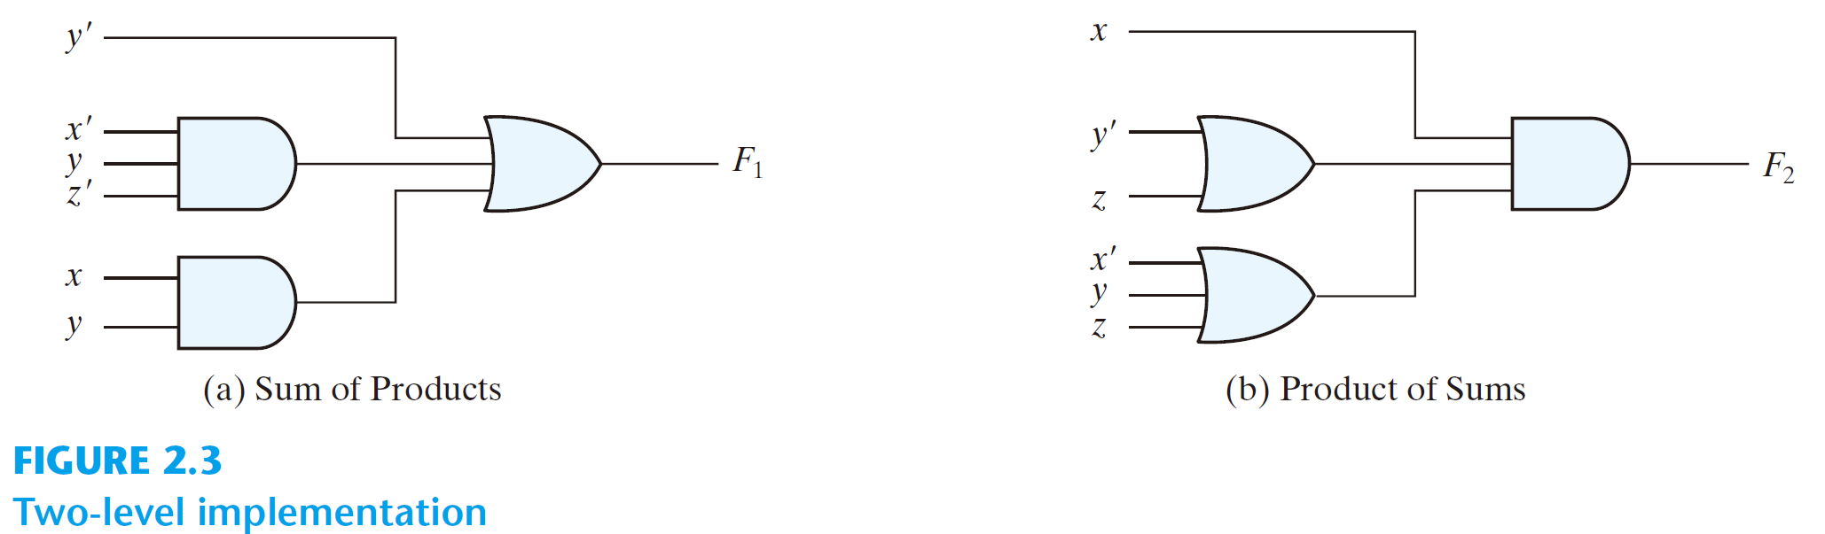
Two-level implementation
  F₁ = y’ + zy + x’yz’

Slide 184
Two-level implementation
  F₂ = x(y‘ + z)(x’ + y + z)

Slide 185
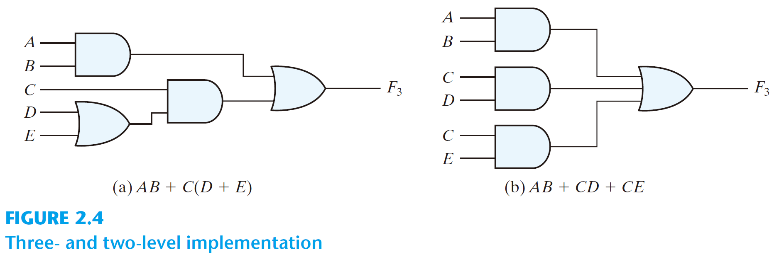
  F₃ = AB + C(D + E)
  = AB + C(D + E) = AB + CD + CE

Slide 186
Other Logic Operations
2^{n} rows in the truth table of n binary variables
2^{2n} functions for n binary variables
16 functions of two binary variables

Slide 187
Other Logic Operations
F(x, y) = x’y’ + x’y + xy’ + xy

Slide 188
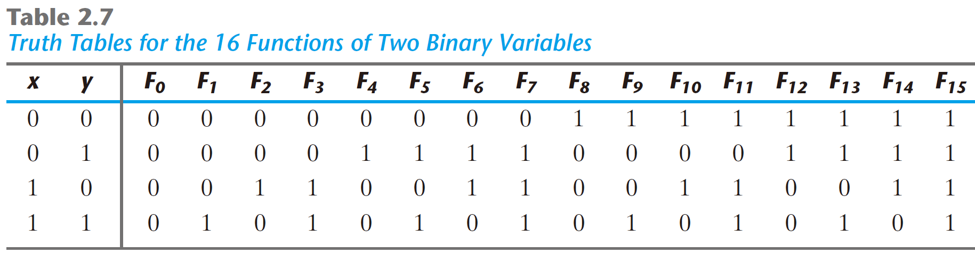

Slide 189
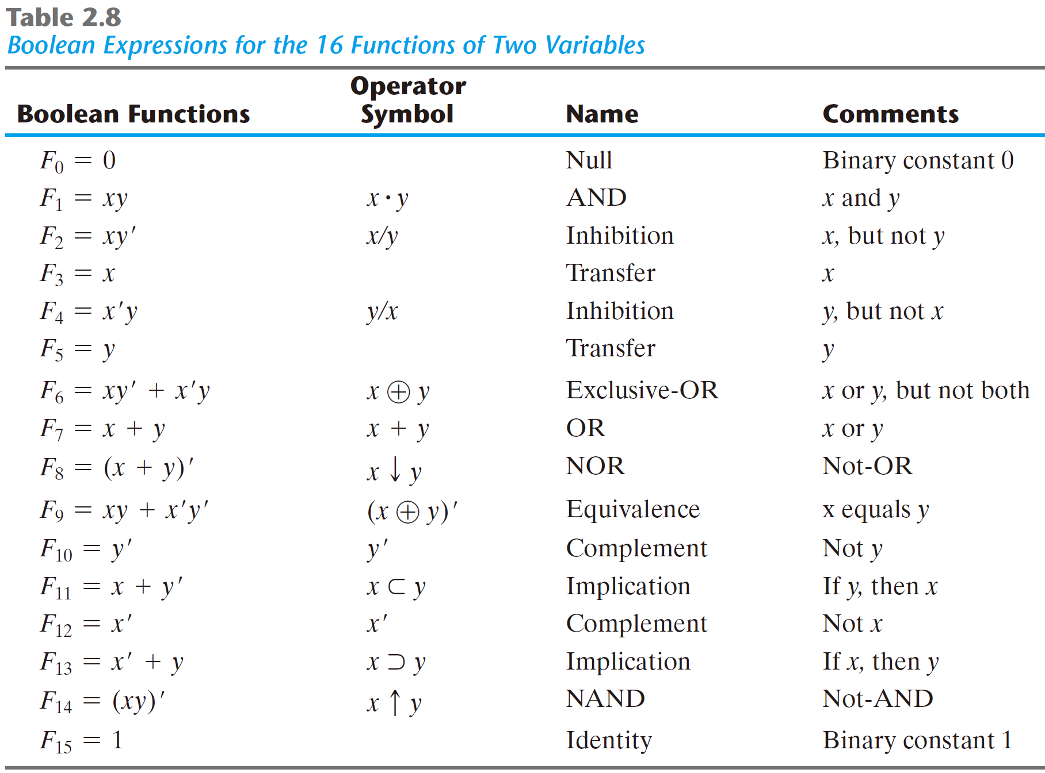

Slide 190
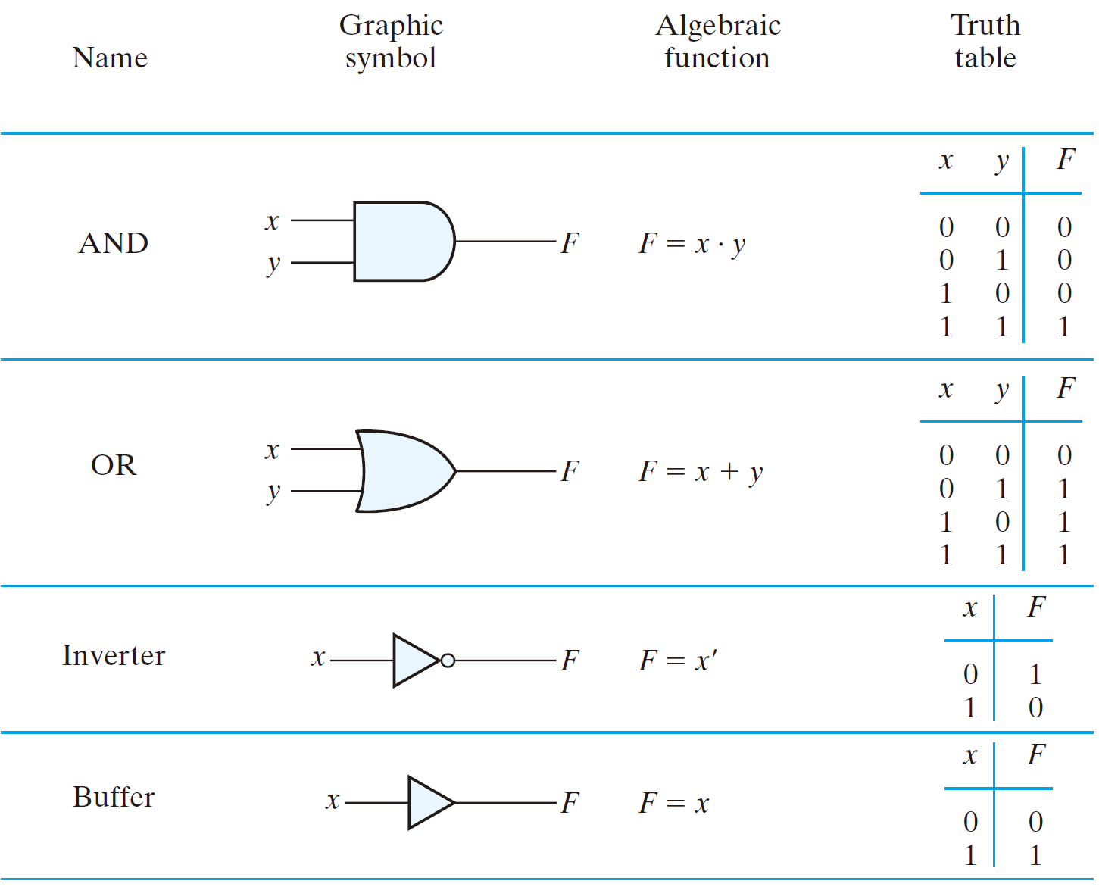

Slide 191
